Slide 1


Computer-Aided Design Sequential & Concurrent statements
Mahdi Aminian
Some slides courtesy of:
“Hardware Systems Modeling”, A. Vachoux, EPFL
CAD slides from Dr. Saheb Zamani

Slide 2
Sequential Statements

Slide 3
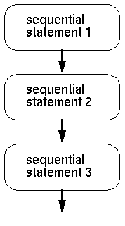
Sequential Statements
Executed according to the order in which they appear
Permitted only within processes and subprograms
Used to describe algorithms

Slide 4
IF Statement
if CONDITION then -- sequential statements end if; if CONDITION then -- sequential statements else -- sequential statements end if; if CONDITION then -- sequential statements elsif CONDITION then -- sequential statements · · · else -- sequential statements end if;
Condition is a boolean expression
Optional elsif sequence
conditions may overlap
priority
Optional else path
executed, if all conditions evaluate to false

Slide 5
IF Statement: Example
entity IF_STATEMENT is port (A, B, C, X : in bit_vector (3 downto 0); Z : out bit_vector (3 downto 0);
end IF_STATEMENT;
architecture EXAMPLE1 of IF_STATEMENT is begin process (A, B, C, X) begin Z <= A; if (X = "1111") then Z <= B; elsif (X > "1000") then Z <= C; end if; end process; end EXAMPLE1;
architecture EXAMPLE2 of IF_STATEMENT is begin process (A, B, C, X) begin if (X = "1111") then Z <= B; elsif (X > "1000") then Z <= C; else Z <= A; end if; end process; end EXAMPLE2;

Slide 6
IF Statement: Example
شرط IF اول داراي بيشترين اولويت است (اگر شرط برقرار باشد بقية دستورات تا آخر skip مي شوند)
دو شرط if و elsif همپوشاني دارند اما به دليل اولويت اولي ← Z <= B
architecture EXAMPLE1 of IF_STATEMENT is begin process (A, B, C, X) begin Z <= A; if (X = "1111") then Z <= B; elsif (X > "1000") then Z <= C; end if; end process; end EXAMPLE1;
architecture EXAMPLE2 of IF_STATEMENT is begin process (A, B, C, X) begin if (X = "1111") then Z <= B; elsif (X > "1000") then Z <= C; else Z <= A; end if; end process; end EXAMPLE2;

Slide 7
CASE Statement
case EXPRESSION is when VALUE_1 => -- sequential statements when VALUE_2 | VALUE_3 => -- sequential statements when VALUE_4 to VALUE_N => -- sequential statements when others => -- sequential statements end case ;
Choice options must not overlap
All choice options have to be covered
single values
selection of values ("|" means "or")
value range
"when others" covers all remaining choice options
type عبارت case header بايد مطابق type مقادير باشد.

Slide 8
CASE Statement Example
entity CASE_STATEMENT is port (A, B, C, X : in integer range 0 to 15; Z : out integer range 0 to 15; end CASE_STATEMENT; architecture EXAMPLE of CASE_STATEMENT is begin process (A, B, C, X) begin case X is when 0 => Z <= A; when 7 | 9 => Z <= B; when 1 to 5 => Z <= C; when others => Z <= 0; end case; end process; end EXAMPLE;

Slide 9
Defining Ranges
entity RANGE_1 is port (A, B, C, X : in integer range 0 to 15; Z : out integer range 0 to 15; end RANGE_1; architecture EXAMPLE of RANGE_1 is begin process (A, B, C, X) begin case X is when 0 => Z <= A; when 7 | 9 => Z <= B; when 1 to 5 => Z <= C; when others => Z <= 0; end case; end process; end EXAMPLE;
entity RANGE_2 is port (A, B, C, X : in std_logic_vector(3 downto 0); Z : out std_logic_vector(3 downto 0); end RANGE_2; architecture EXAMPLE of RANGE_2 is begin process (A, B, C, X) begin case X is when "0000" => Z <= A; when "0111" | "1001" => Z <= B; when "0001" to "0101" => -- wrong Z <= C; when others => Z <= 0; end case; end process; end EXAMPLE;

Slide 10
Mistakes in 1-Bit Full Adder: Algorithmic Architecture
Mistake 1: operator “+” is not defined for std_logic_vector
Mistake 2: signal assignment will be actually executed when the process suspends
If all inputs are “1”, just the last statement will be executed
Mistake 3: signal “temp” is in both side of assignment -> Combinational Loop (WRONG!)
Mistake 4: Because the value of ”temp” is not determined when it’s reading -> inferred LATCH (WRONG!)
architecture algo of fadd1 is
signal temp : std_logic_vector (1 downto 0); begin
process (opa, opb, opc) begin
temp <= “00”;
if opa=‘1’ then temp <= temp +1; end if;
if opb=‘1’ then temp <= temp +1; end if;
if opc=‘1’ then temp <= temp +1; end if;
end process;
end EXAMPLE;

Slide 11
Signed / Unsigned Numbers

Slide 12
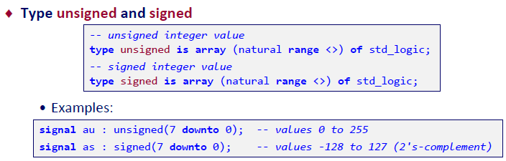
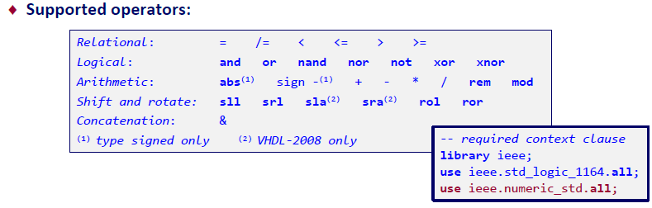
Bit-Based Numerical Data Representation

Slide 13







Shift Operators
Logical Shift
Arithmetic Shift
Rotation

Slide 14
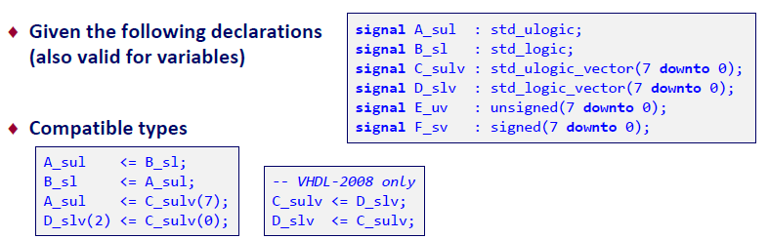
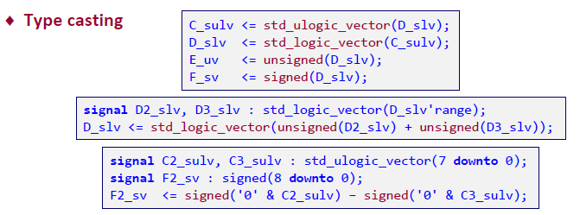
Working with std_(u)logic(_vector) and (un)signed

Slide 15
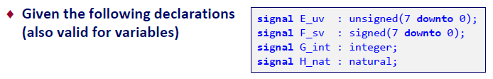
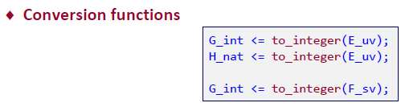


Working with (un)signed and integer

Slide 16
Variable

Slide 17
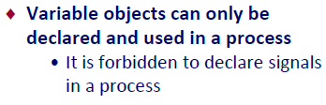
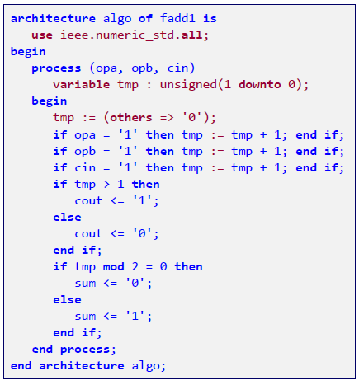

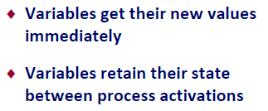
1-Bit Full Adder: Algorithmic Architecture

Slide 18

Signals or Variables?

Slide 19
For … Loop

Slide 20
FOR Loops
entity FOR_LOOP is port (A : in integer range 0 to 3; Z : out bit_vector (3 downto 0)); end FOR_LOOP; architecture EXAMPLE of FOR_LOOP is begin process (A) begin Z <= "0000"; for I in 0 to 3 loop if (A = I) then Z(I) <= `1`; end if; end loop; end process; end EXAMPLE;
Loop parameter is implicitly declared
cannot be declared externally
read only access
not visible outside the loop
The loop parameter adopts all values from the range definition
integer ranges
enumerated types
type T_STATE is (START, EXECUTE, FINISH); …
signal CURRENT_STATE, NEXT_STATE : T_STATE ;

Slide 21

Loop Syntax
[LOOP_LABEL :] for IDENTIFIER in DISCRETE_RANGE loop -- sequential statements end loop [LOOP_LABEL] ; [LOOP_LABEL :] while CONDITION loop -- sequential statements end loop [LOOP_LABEL] ;
Optional label
Use especially for nested loops
Range attributes
‘low
‘high
‘range
Synthesis requirements: - Loops must have a fixed range - 'while' constructs usually cannot be synthesized

Slide 22
Loop Examples
entity CONV_INT is port (VECTOR: in std_logic_vector(7 downto 0); RESULT: out integer); end CONV_INT;
architecture A of CONV_INT is begin process(VECTOR) variable TMP: integer; begin TMP := 0; for I in 7 downto 0 loop if (VECTOR(I)='1') then TMP := TMP + 2**I; end if; end loop; RESULT <= TMP; end process; end A;
architecture B of CONV_INT is begin process(VECTOR) variable TMP: integer; begin TMP := 0; for I in VECTOR'range loop if (VECTOR(I)='1') then TMP := TMP + 2**I; end if; end loop; RESULT <= TMP; end process; end B;
architecture C of CONV_INT is begin process(VECTOR) variable TMP: integer; variable I : integer; begin TMP := 0; I := VECTOR'high; while (I >= VECTOR'low) loop if (VECTOR(I)='1') then TMP := TMP + 2**I; end if; I := I - 1; end loop; RESULT <= TMP; end process; end C;

Slide 23
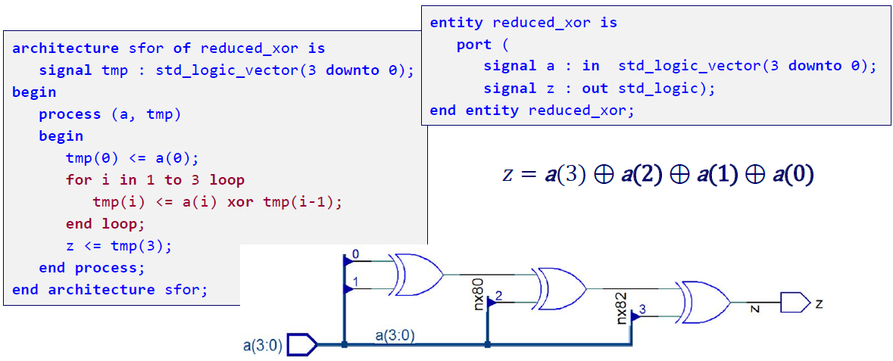
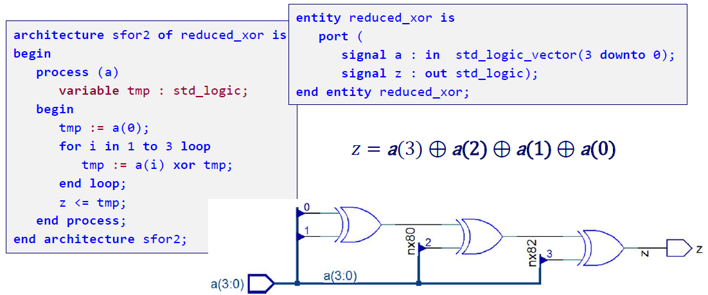
Loop Example

Slide 24
Concurrent Statements

Slide 25
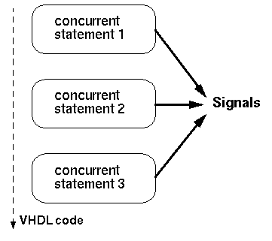
Concurrent Statements
Concurrent statements are executed at the same time, independent of the order in which they appear

Slide 26
Conditional Signal Assignment
TARGET <= VALUE_1 when CONDITION_1 else VALUE_2 when CONDITION_2 else . . . VALUE_n;
Condition is a Boolean expression
Mandatory else path, unless unconditional assignment
conditions may overlap
priority
Similar to if ..., elsif ..., else constructs
هرگاه تغييري روي سيگنالهاي سمت راست رخ دهد اين انتساب بار ديگر ارزيابي مي شود (هميشه فعال است)

Slide 27
Conditional Signal Assignment (Example)
entity CONDITIONAL_ASSIGNMENT is port (A, B, C, X : in bit_vector (3 downto 0); Z_CONC : out bit_vector (3 downto 0); Z_SEQ : out bit_vector (3 downto 0)); end CONDITIONAL_ASSIGNMENT; architecture EXAMPLE of CONDITIONAL_ASSIGNMENT is begin -- Concurrent version of conditional signal assignment Z_CONC <= B when X = "1111" else C when X > "1000" else A; -- Equivalent sequential statements process (A, B, C, X) begin if (X = "1111") then Z_SEQ <= B elsif (X > "1000") then Z_SEQ <= C; else Z_SEQ <= A; end if; end process; end EXAMPLE;
توجه: در پروسس، همة سيگنالهاي سمت راست انتساب در ليست حساسيت آمده اند.

Slide 28
Selected Signal Assignment
with EXPRESSION select TARGET <= VALUE_1 when CHOICE_1, VALUE_2 when CHOICE_2 | CHOICE_3, VALUE_3 when CHOICE_4 to CHOICE_5, · · · VALUE_n when others;
Choice options must not overlap
All choice options have to be covered
single values
value range
selection of values ("|" means "or")
"when others" covers all remaining choice options
Similar to case ..., when ... constructs

Slide 29
Selected Signal Assignment : Example
entity SELECTED_ASSIGNMENT is port (A, B, C, X : in integer range 0 to 15; Z_CONC : out integer range 0 to 15; Z_SEQ : out integer range 0 to 15); end SELECTED_ASSIGNMENT; architecture EXAMPLE of SELECTED_ASSIGNMENT is begin -- Concurrent version of selected signal assignment with X select Z_CONC <= A when 0, B when 7 | 9, C when 1 to 5, 0 when others; -- Equivalent sequential statements process (A, B, C, X) begin case X is when 0 => Z_SEQ <= A; when 7 | 9 => Z_SEQ <= B; when 1 to 5 => Z_SEQ <= C; when others => Z_SEQ <= 0; end process; end EXAMPLE;

Slide 30
Concurrent Statements: Summary
Modeling of multiplexers
conditional signal assignment: decision based upon several signals
selected signal assignment: decision based upon values of a single signal

